Slide 1
SOLID principles

Slide 2
Overview
The first five principles of Object Oriented Design (OOD)
Defined by Robert C. Martin in the early 2000s
Creating a system that is easy to maintain and extend over time

Slide 3
The principles
(S) SRP - Single Responsibility Principle
(O) OCP - Open/Closed Principle
(L) LSP - Liskov Substitution Principle
(I) ISP - Interface Segregation Principle
(D) DIP - Dependency Inversion Principle

Slide 4
Interface Segregation Principle

Slide 5
The common approach
Low-level module is used by many different high-level modules (clients), all of them having a specific way of working the low-level module.
This leads to problems:
Interface pollution - an interface is being polluted with methods that it doesn't require making it "fat“ and non-cohesive.
Degenerate method implementations in implementing classes.

Slide 6
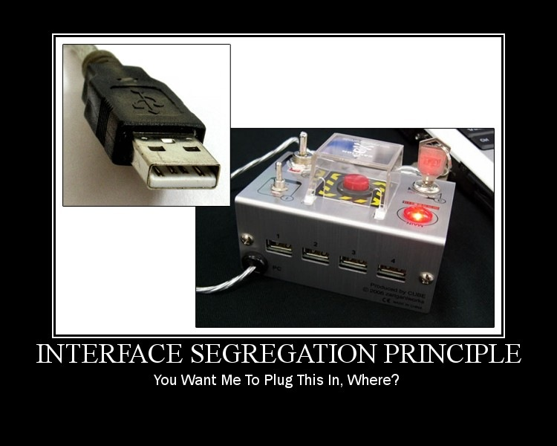
The problem illustrated

Slide 7
ISP defined
Clients should not be forced to depend on methods they do not use.

Slide 8
Example: Car

Slide 9
Exercise: Factory
The story:
There is a Factory that was first specialized in production of car parts but quickly moved to production of formula one and motorcycle parts.
Task:
Refactor the Factory application to be compliant with the interface segregation principle. Implement factories that can produce one type of parts and one with all part types.
Hint:
Consider moving methods in different interfaces and implement multiple Factories. Rename the methods if necessary.

Slide 10
Single Responsibility Principle

Slide 11
The common approach
Classes tend to have many responsibilities. In a class that has more than one responsibility, the responsibilities become coupled. Changes to one responsibility may impair or inhibit the class's ability to meet the others. This kind of coupling leads to fragile designs that break in unexpected ways when changed.
A responsibility is defined as an axis of change. A class has multiple responsibilities if it has more than one reason for change.

Slide 12
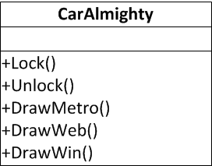
Example: CarAlmighty
Problems:
The GUI functionalities needs to be separated.
The logging functionalities needs to be separated.
Changes to the GUI or logging will force changes to the car.

Slide 13
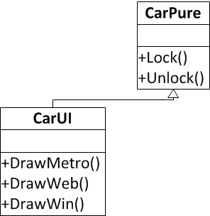
SRP defined
A class should have only one reason to change.

Slide 14
Example: CarAlmighty

Slide 15
Exercise: AcmeCar
The story:
There is an AcmeCar with basic functionalities Lock/Unlock but as the implementation progressed this class included logging of exceptions and logging of state.
Now the client wants to change the computer and the logger that should log the messages in:
-Exception messages should be logged on the cloud
-Status messages should be logged in the clients phone
Task:
Refactor the AcmeCar to be responsible only for Lock/Unlock and export the logging functionalities in separate classes.

Slide 16
Dependency Inversion Principle

Slide 17
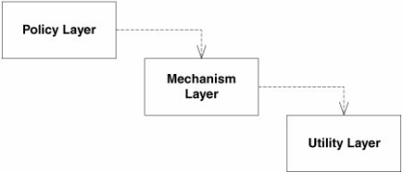
The common approach
Traditionally high-level modules have been dependent on low-level modules.
Examples:
User management module would depend on a DAO module that persists the user data in a relational database.
Checkout module would depend on a payment gateway such as PayPal.
The password management module would depend on a SMTP server for sending the "forgot password" email.

Slide 18
Hence the problems
Changes to low-level modules have direct effects on the high-level modules.
Change to the API of a low-level module would require changes in the code of a high-level module that depends on it.
The tight coupling between modules makes it very hard to replace low-level modules with alternatives. The same is problem when it comes to reusing high-level modules in different contexts.
Replacing the DAO module that stores the data in a relational database with one that stores it in a NoSQL database.
Replacing PayPal with Google Wallet.
Opting for an SMS "forgot password" notification rather than an email based one.

Slide 19
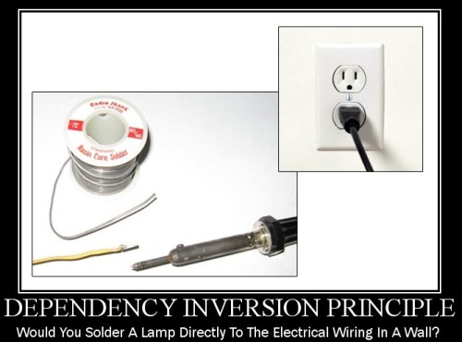
The problem illustrated

Slide 20
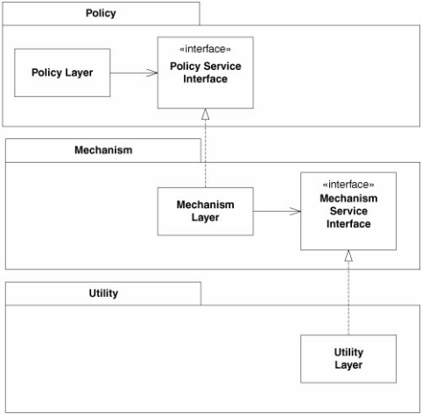
DIP defined
High-level modules should not depend on low-level modules. Both should depend on abstractions.
Abstractions should not depend upon details. Details should depend upon abstractions.

Slide 21
Exercise: AcmeDipCar
The story:
The AcmeCar from the previous example is required to change once more. When the car is sold the client should be able to specify the logger and the computer where the messages should be logged.
Task:
Refactor the AcmeCar to be able to accept the loggers from the outside and depend only on interfaces.
Consider using the Singleton principle.
Consider using events to further decouple the car implementation from the logging.

Slide 22
Homework

Slide 23
HomeWork SOLID: OCP and LSP
Create a project that will have:
-Bad example for Open/Closed principle
-Good example for Open/Closed principle
-Bad example for Liskov Substitution Principle
-Good example for Liskov Substitution Principle
Ref: http://www.codeproject.com/Articles/703634/SOLID-Architecture-principles-using-simple-Csharp

